Slide 1
Module-2
By: Piyush Vashistha

Slide 2
Module No. | Content | Teaching Hours
I. | Neural Networks: Fundamentals of Artificial Neural Network (ANN), Human Brain, Supervised Vs Unsupervised Learning, Models of ANN, ANN models: Rosenblatt’s Perception, McCulloch & Pitts Model, Single Layer Perceptron, Learning Methods in Perceptron, Linearly Separable Task and XOR Problem, Multi-Layer Perceptron, ADALINE, MADALINE Network Multilayered Neural Architecture: Activation functions (ReLU, Sigmoid, tanh, etc.), Gradient Descent, Back Propagation (BP) Learning, learning rate, momentum, Loss Function in Neural Network, Optimizers in Neural Networks, Hessian Matrix, Heuristics for making Back-Propagation algorithm perform better, Applications of Neural Network. Radial Basis Neural Network | 20
II. | Probabilistic Models: Probabilistic Models, Maximum Likelihood Estimation, Linear Regression, Logistic Regression Deep Learning: AI vs ML vs DL, Deep learning capabilities, Data Pre-processing, training and testing, confusion matrix. Bias and Variance, Vanishing gradients. Convolutional Neural Network (CNN)- Basic terminologies in CNN (Convolution, Filter/Kernel, Padding, Pooling), Architecture of CNN, Different Models of CNN, Classification of MNIST dataset images with CNN. Recurrent Neural Networks (RNN): Sequential Processing, Stability Gated Nets- LSTM (Long Short-Term Memory), Gated Recurrent Unit), Examples. | 20

Slide 3
CNN
CNN is also known as Convnet, is a special kind of NN for processing data that has a known grid-like topology like time-series data (1D) or Images (2D)
ANN-Matrix Multiplication
CNN-Convolution operation
CNN is inspired from Visual Cortex.
CNN is also inspired from Neocognitron.
The neocognitron is a hierarchical, multilayered artificial neural network proposed by Kunihiko Fukushima in 1979. It has been used for Japanese handwritten character recognition and other pattern recognition tasks, and served as the inspiration for CNN.

Slide 4
History
Yann LeCun developed first CNN in 1998 at AT & T Lab. The purpose of this CNN was to scan Bank Cheques.
Then Microsoft used CNN for OCR based hand writing recognition.
After some time, CNN is used for Facial Recognition, Self driving cars

Slide 5
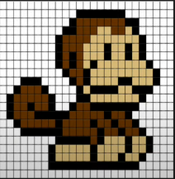
Why not use ANN for Image data?
High Computational Cost
Overfitting
Loss of important info like spatial arrangement of pixels

Slide 6
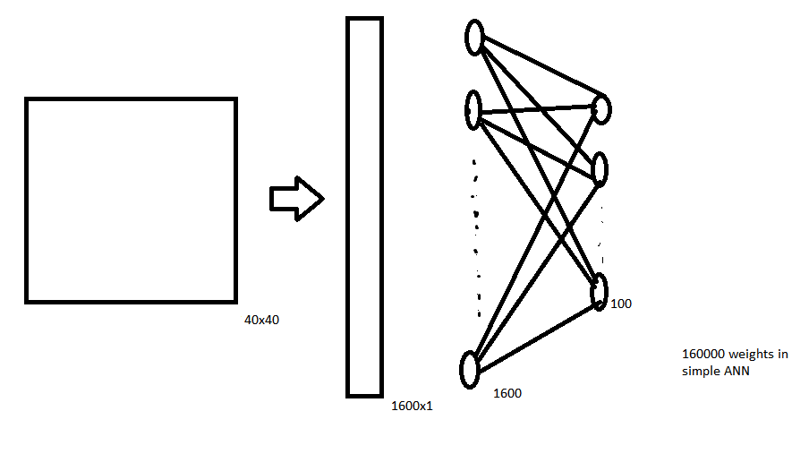
Reason 1: High Computational Cost
Suppose Image Size is 40x40.

Slide 7
Reason 2: Overfitting
Due to every neuron is connected to every other neuron of next layer, this will try to capture every minute pattern and hence it will result in Overfitting
Reason 3: Loss of important info like spatial arrangement of pixels

Slide 8
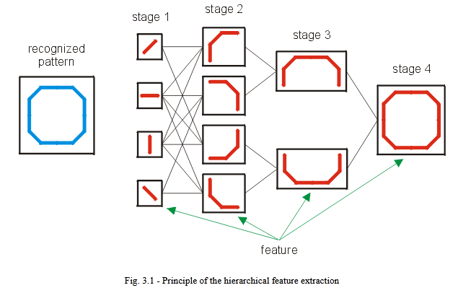
Low level features to High level features

Slide 9
Applications of CNN
Image Classification
Object Localization
Object Detection
Face Detection and Recognition
Image Segmentation
Super resolution
Colorization
Pose Estimation (used in Health domain apps and games play station)

Slide 10
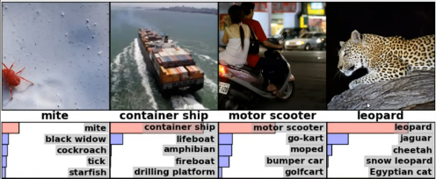
1.Image Classification

Slide 11
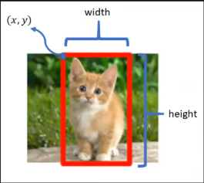
2.Object Localization

Slide 12
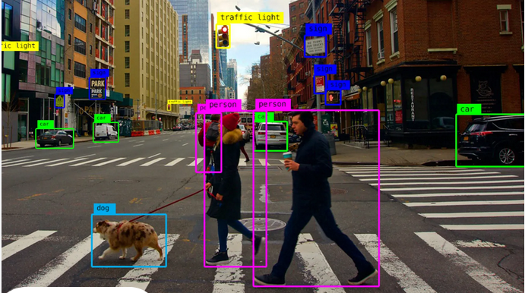
3.Object Detection

Slide 13
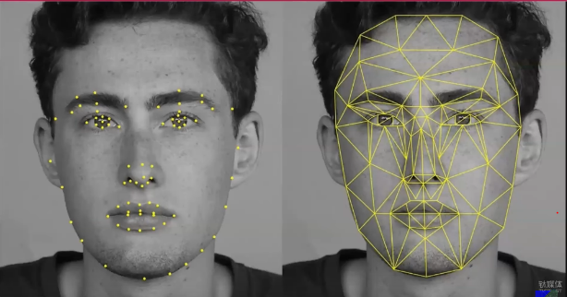
4.Face Detection and Recognition

Slide 14
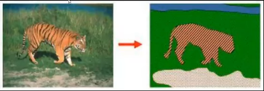
5.Image Segmentation

Slide 15
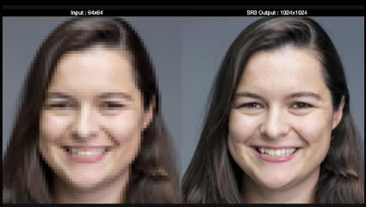
6.Super resolution

Slide 16
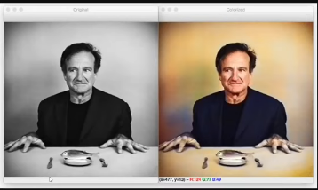
7.Colorization

Slide 17
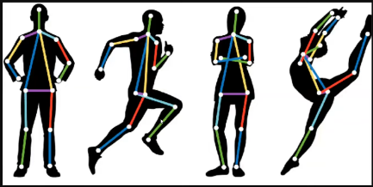
8.Pose Estimation

Slide 18
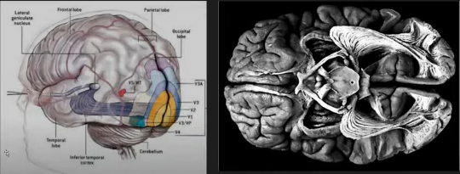
Human Visual Cortex

Slide 19
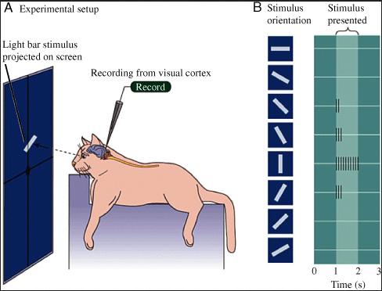
The Visual System and the Brain: Hubel and Wiesel

Slide 20
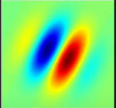
Simple Cell- (or Orientation Cell – or Feature Detector or Preferred Stimuli)
has Smaller Receptive field
Used for detecting primitive features like edge detection
Complex Cell-
has Bigger Receptive field
Used for detection of High level features

Slide 21
CNN has 3 layers
Convolution Layer
Convolution operation
Activation function
Padding
Strides
Pooling Layer
FC layer

Slide 22
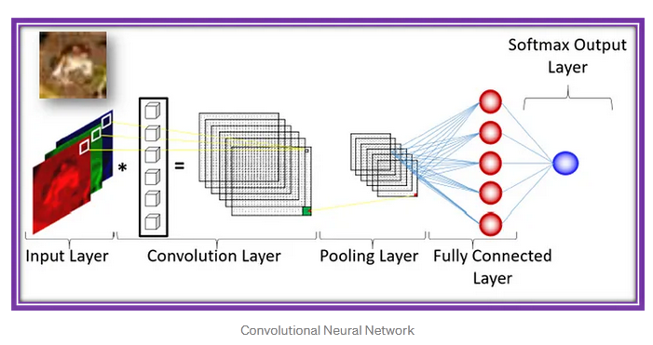

Slide 23
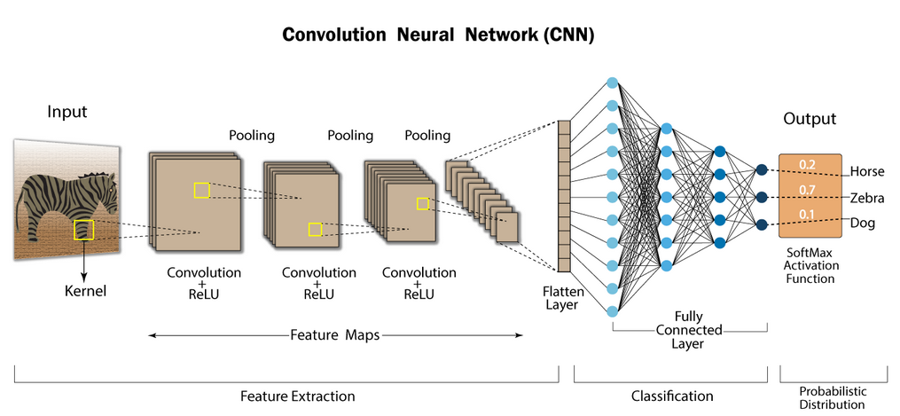

Slide 24
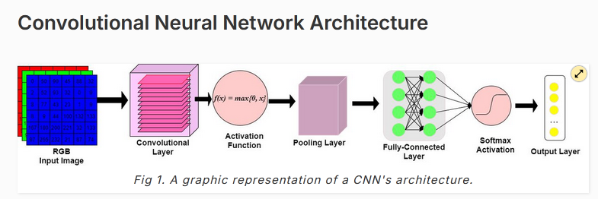

Slide 25
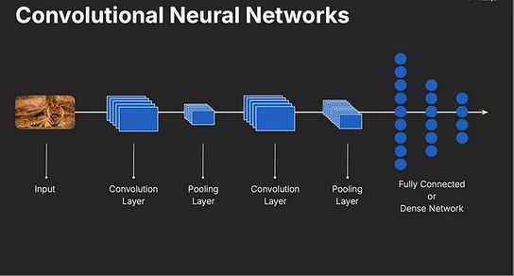

Slide 26
Building blocks of CNN architecture:
1. Convolutional Layer:
Conv. Layers will compute the output of nodes that are connected to local regions of the input matrix.
Dot products are calculated between a set of weights (commonly called a filter) and the values associated with a local region of the input.
2. ReLu (Activation) Layer:
The output volume of the Conv. Layer is fed to an elementwise activation function, ReLu.
The ReLu layer will determine whether an input node will 'fire' given the input data. This 'firing' signals whether the
convolution layer's filters have detected a visual feature.
The dimensions of the volume are left unchanged.
3. Pooling Layer:
A down-sampling strategy is applied to reduce the width and height of the output volume.
4. Fully-Connected Layer:
The output volume, i.e. 'convolved features', are passed to a Fully-Connected Layer of nodes.
Like conventional neural-networks, every node in this layer is connected to every node in the volume of features
being fed-forward.
The class probabilities are computed and are outputted in a 3D array (the Output Layer) with dimensions:
[1 x 1 x K], where K is the number of classes.

Slide 27
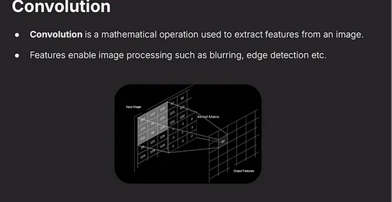
1.Convolution Layer

Slide 28
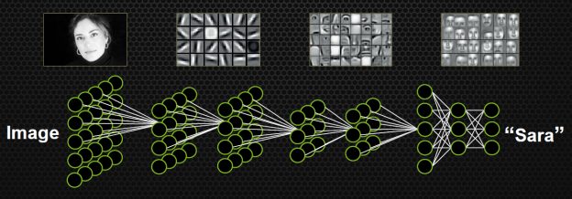
Convolution Layer

Slide 29

a. Convolution Operation (for edge detection) Edge is change in intensity

Slide 30
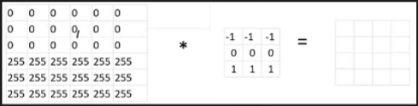
Convolution Operation
The given filter is the horizontal filter which detects horizontal edge
0 | 0 | 0 | 0
255 | 255 | 255 | 255
255 | 255 | 255 | 255
0 | 0 | 0 | 0

Slide 31
Shape of Feature Map in Grayscale Image
Image Filter Feature Map
6x6 3x3 4x4
28x28 3x3 26x26
nxn fxf (n-f+1)x(n-f+1)

Slide 32
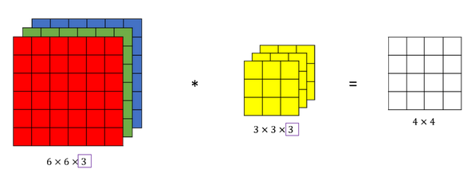
Shape of Feature Map in RGB Image We get Single Channel Feature Map of shape (n-m+1)x(n-m+1)

Slide 34
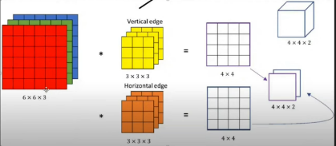
Applying Multiple Filters in a Single Image

Slide 35
b. Padding: To retain the shape of the original image.

Slide 36
Feature Map after applying Convolution on Zero-padded image

Slide 37
Benefit of padding: Retain Original Shape
Image after applying Convolution and before padding : n-f+1
Image after applying Convolution and after padding: n-f+1+2p
Let Original Size of Image : 5x5
Image after applying Convolution and before padding : (n-f+1)x (n-f+1)
=(5-3+1)x(5-3+1)
=3x3
Image after applying Convolution and after padding : (n-f+1+2)x (n-f+1+2)
=(5-3+1+2)x(5-3+1+2)
=5x5
=Original Image Size

Slide 38
Padding in Keras
padding=valid It means padding is not used
Padding=same It means padding is used and it keeps the shape same as of Original Image

Slide 39
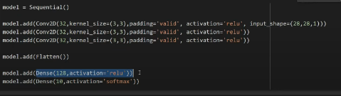
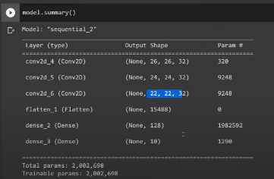

Slide 40
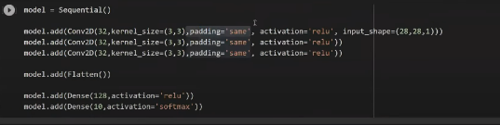
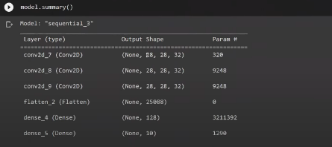

Slide 41
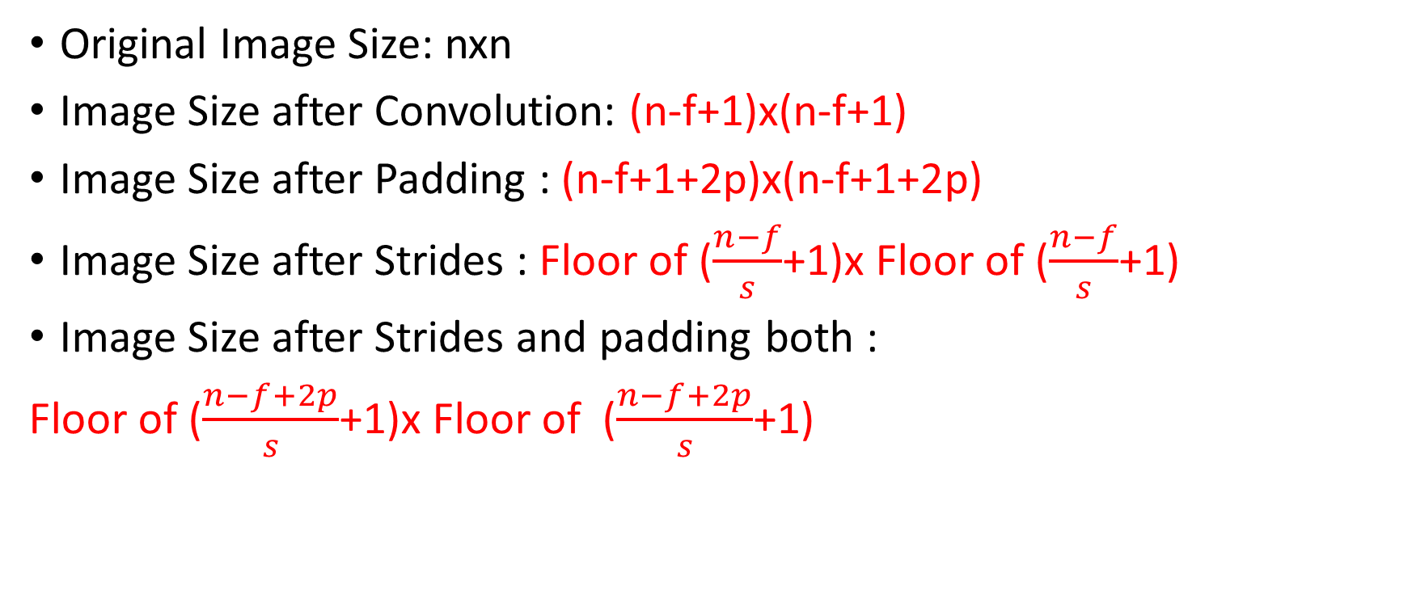
(c)Strides : It will again decrease the shape of the image. If we are using any value other than default value i.e. , then it is known as Strided Convolution
Original Image Size: nxn
Image Size after Convolution: (n-f+1)x(n-f+1)
Image Size after Padding : (n-f+1+2p)x(n-f+1+2p)
Image Size after Strides : Floor of ($\frac{n−f}{s}$+1)x Floor of ($\frac{n−f}{s}$+1)
Image Size after Strides and padding both :
Floor of ($\frac{n−f+2p}{s}$+1)x Floor of ($\frac{n−f+2p}{s}$+1)

Slide 42
If stride is 2

Slide 43
Reason of Floor: If stride is not 1, then some elements can be remaining for convolution
For example, image size is 6x7 and we are considering no padding
Image size mxn is 6x7,stride is 2 and filter size is 3x3
so Feature map size =(m-f)/2 +1 x (n-f)/2+1
=(6-3)/2+1 x (7-3)/2+1
=2.5 x 3
=2x3

Slide 44
Why Strides are required? Or Why we use Strided Convolution?
When we want to capture High level Features
For making training faster

Slide 45
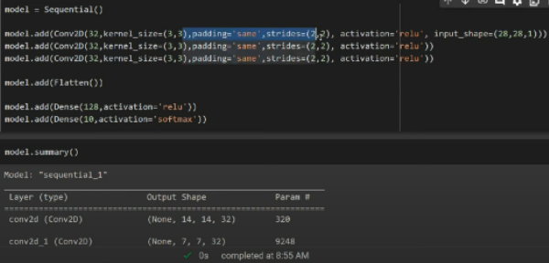

Slide 46
2.Pooling Operation
It solves 2 purposes:-
Memory issues
Translation variance

Slide 47
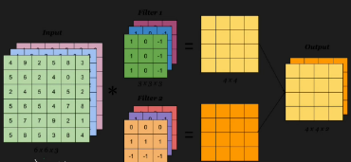
1.Memory issue
Suppose the image size is 228x228x3 and there are 100 filters, so the feature map size will be 226x226x100.
Suppose the numbers are stored in 32 bits. So total size in bits=226x226x100x32 bits=163,443,200/8x1024x1024 MB=19.48 MB and this is the size of 1 training data only. If we are giving 100 training data, then this size becomes 19.48x100 MB=1948 MB=1.9 GB (too large)
228x228x3 100 filters 226x226x100

Slide 48
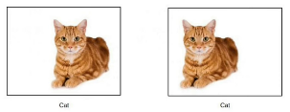
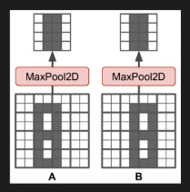
2.Translation Invariance

Slide 49
Pooling

Slide 50
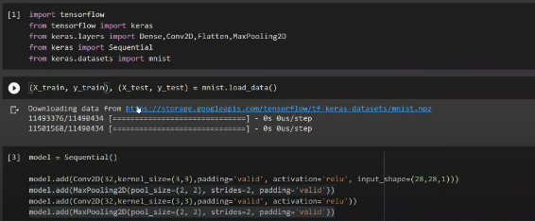

Slide 51
Advantages of Pooling
Size is reduced
Translation invariance
Features are enhanced when we use max pooling
No need of training because Pooling operation is an aggregate function.

Slide 52
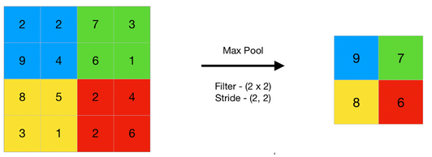
Types of Pooling
Max Pooling
Min Pooling
Average Pooling
Global Pooling- Global Max Pooling and Global Average Pooling
Global Max Pooling can be used in place of Flatten()

Slide 53
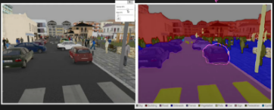
Disadvantages of Pooling 1.If location matters 2.Loss of lot of information

Slide 54
Uses:-
 | Purpose
Convolution | To detect edges
Padding | To retain the original shape
Strides | For faster training and to extract High level Features
Pooling | To tackle Memory issue and Translation variance a. Downsample Feature Map b. Feature maps are by default location variant but we want location invariant, so we do pooling

Slide 55
Different CNN architectures:-
LeNET- developed by Yann LeCun
AlexNet
GoogleNet
VGGNet
ResNet
Inception

Slide 56
LeNet or LeNet-5
Developed by Yann LeCun.
He started working since 1989 and found LeNet in 1998.
He was working on US Navy Postal Service project

Slide 57
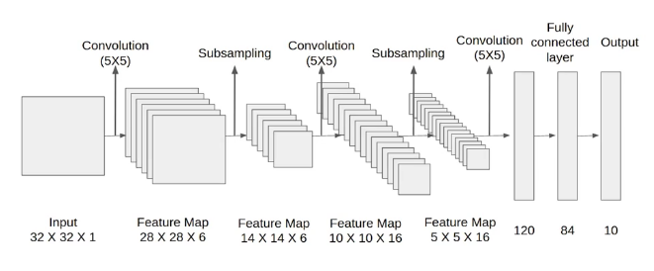
Filter size=5x5,Pooling=0,stride=1 in convolution and stride=2 in pooling No. of filters=6,16,120

Slide 58
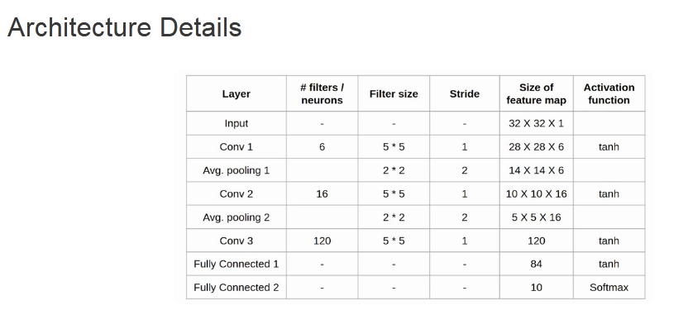
LeNet-5

Slide 59
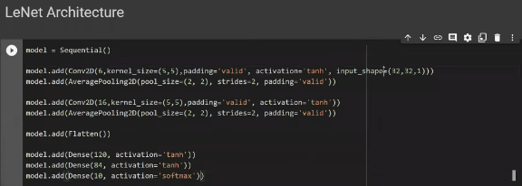
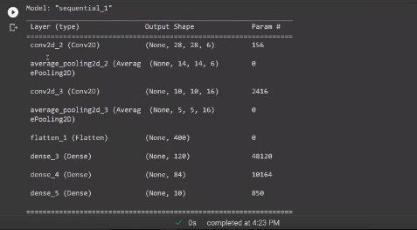

Slide 60
Similarity of ANN with CNN
In ANN, Relu[( w₁x₁+w₂x₂+……w₇₈₄x₇₈₄)+b]
In CNN Relu[(w₁x₁+w₂x₂+……w₉x₉)+b]

Slide 61
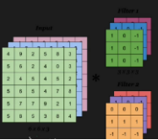
CNN vs ANN Number of trainable parameters: It is independent of Image Size and it is the best part of CNN which reduces computational cost It is dependent on Kernel Size and No. of kernels
If no. of filters are 50 and kernel size is 3x3x3
So total no. of trainable parameters are (3x3x3x50)+50 where 3x3x3x50 are weights and 50 is bias
=27x50+50
=1400
228x228x3 No. of filters =50

Slide 62
Why use Pre-trained Models?
Data Hungry-we need Image data as well as it should be labelled
Time

Slide 63
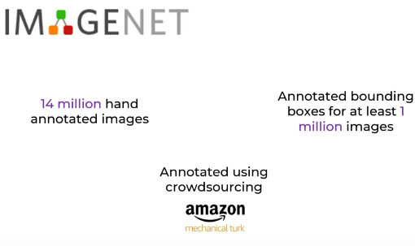
ImageNET dataset
It is visual dataset of images.
All scientists were working on Models and Algorithms but Fei Fei Lie was working on datasets and she developed this ImageNET dataset
The ImageNet database now contains more than 14 million annotated images.
https://www.image-net.org/

Slide 64
ILSVRC (ImageNet Large Scale Visual Recognition Challenge) or ImageNet Challenge
Held in 2010
Many Researchers were participated
Used subset of original dataset and only 1000 classes
But at this time, Machine Learning were mostly used and Feature Extraction is done manually using SIFT and HOG
At this Error Rate was 28 %.
 | Original ImageNet Dataset | ImageNet Challenge Dataset
No of Images | Around 14 Million | Around 1 Million
No. of Classes | Around 20,000 | 1000

Slide 65
Error Rate decrease year by year
Year | Model | Error Rate
2010 | ML Model | 28%
2011 | ML Model | 25%
2012 . At this time DL is evolved and Geoffrey Hilton used AlexNET, GPU, ReLu activation function and reduces it to | AlexNET | 16.4%
2013 | ZFNET | 11.7%
2014 | VGG | 7.3%
2015 | GoogleNET | 6.7%
2016 Human Error Rate is 5% and ResNET is better than Human | ResNET | 3.5%

Slide 66
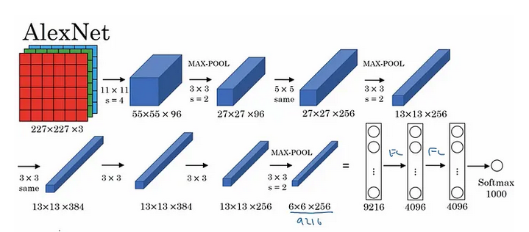
AlexNet: 5 Convolution layers and 2 FC layers

Slide 67
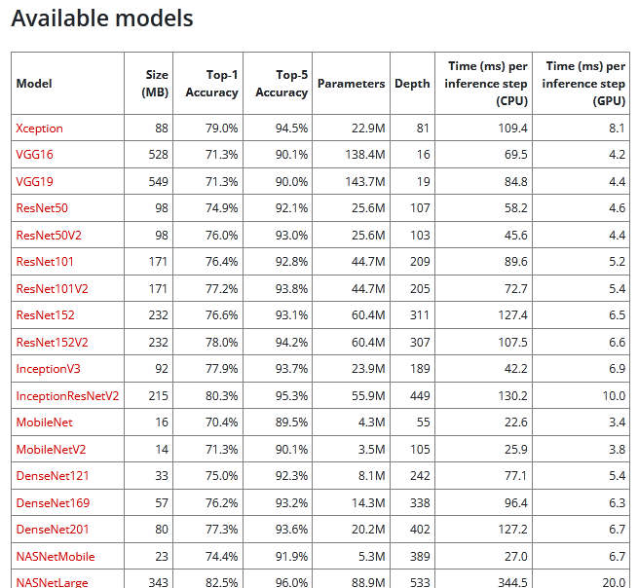

Slide 68
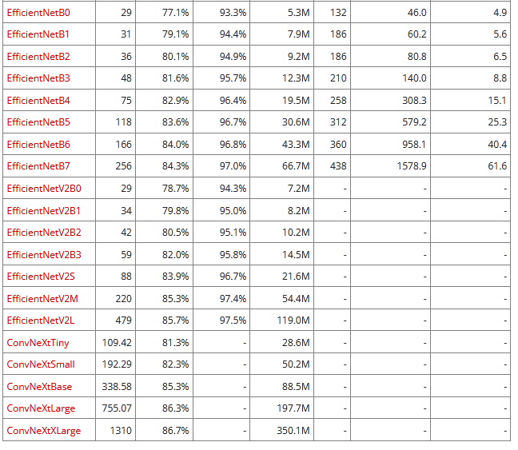

Slide 69
VGG16
VGG16 is a convolutional neural network trained on a subset of the ImageNet dataset, a collection of over 14 million images belonging to 22,000 categories. K. Simonyan and A. Zisserman proposed this model in the 2015 paper, Very Deep Convolutional Networks for Large-Scale Image Recognition.
In the 2014 ImageNet Classification Challenge, VGG16 achieved a 92.7% classification accuracy.
VGG-Visual Geometry Group
16 layers---------13 convolution layers+ 3 FC layers

Slide 70
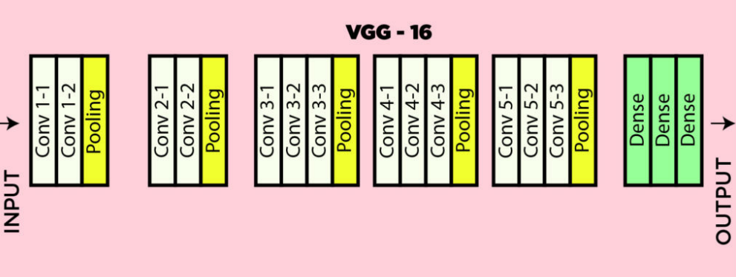

Slide 71
Transfer Learning
Transfer Learning is an approach where we use one model trained on a machine learning task and reuse it as a starting point for a different job.
Now suppose we have many images of two kinds of cars: Ferrari sports cars and Audi passenger cars. We want to generate a model that can classify an image as one of the two classes. Writing our own CNN is not an option since we do not have a dataset sufficient in size. Here's where Transfer Learning comes to the rescue!
We know that the ImageNet dataset contains images of different vehicles (sports cars, pick-up trucks, minivans, etc.). We can import a model that has been pre-trained on the ImageNet dataset and use its pre-trained layers for feature extraction.
Now we can't use the entirety of the pre-trained model's architecture. The Fully-Connected layer generates 1,000 different output labels, whereas our Target Dataset has only two classes for prediction. So we'll import a pre-trained model like VGG16, but "cut off" the Fully-Connected layer - also called the "top" model.

Slide 72
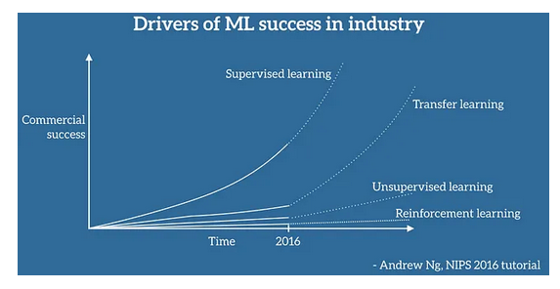

Slide 73
Once the pre-trained layers have been imported, excluding the "top" of the model, we can take 1 of 2 Transfer Learning approaches.
1. Feature Extraction Approach
2. Fine-Tuning Approach

Slide 74
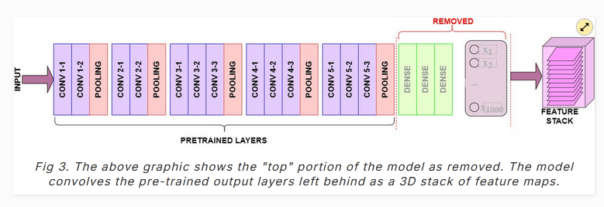
1. Feature Extraction Approach
We'll import the Convolutional and Pooling layers but leave out the "top portion" of the model (the Fully-Connected layer).
Recall that our example model, VGG16, has been trained on millions of images - including vehicle images. Its convolutional layers and trained weights can detect generic features such as edges, colors, wheels, windshields, etc.

Slide 75
2. Fine-Tuning Approach
The goal of fine-tuning is to allow a portion of the pre-trained layers to retrain.
Fine-tuning a Pre-trained Model entails:
Bootstrapping a new "top" portion of the model (i.e., Fully-Connected and Output layers)
Freezing pre-trained convolutional layers
Un-freezing the last few pre-trained layers training.
Un-freezing the last few pre-trained layers training.
The frozen pre-trained layers will convolve visual features as usual. The non-frozen (i.e., the 'trainable') pre-trained layers will be trained on our custom dataset and update according to the Fully-Connected layer's predictions

Slide 76
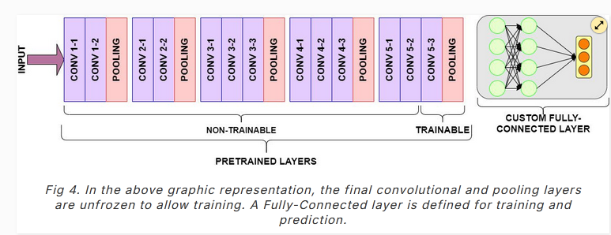

Slide 77
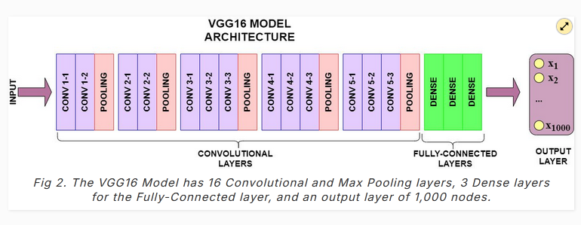
Why Transfer Learning works?

Slide 78
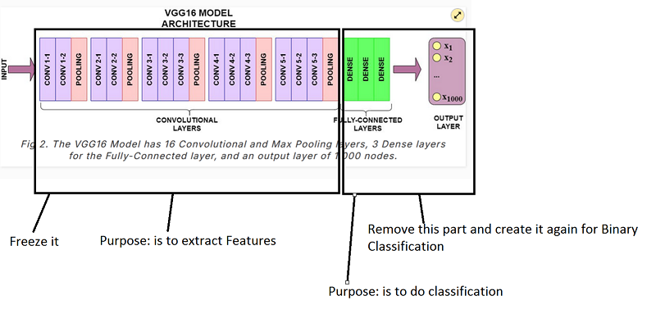

Slide 79
VGG16 is already trained on ImageNet dataset which has 1000 classes
VGG16 is a pre-trained model
In Transfer Learning, we take the Conv_base part (i.e Convolution layers and max pooling layers) as it is or we can say we do not train it again or we can say we freeze it. We only make the changes in FC layer, so that we can only solve problems for Binary Classification. As Original VGG16 was doing Multi-class classification

Slide 80

Ways of Transfer Learning
Feature Extraction- We freeze all Convolution and Max pool layers
Fine-Tuning- We freeze starting Convolution and Max pool layers

Slide 81
Save the trained Model and Load the model
# After training your model:
model.save("my_trained_model.h5")
To load the saved model later:
from keras.models import load_model
scratch_model = load_model('scratch_img_model.h5')
scratch_model.summary()

Slide 82


Slide 83

Shear transformation, is a geometric transformation that shifts image pixels along one axis (horizontally or vertically) while maintaining the original image size and shape, resulting in a skewed or slanted appearance

Slide 84
RNN

Slide 85
 | ANN | CNN | RNN
Data | Tabular Data | Grid data like Images, Videos etc. | Sequential data

Slide 86
RNN is type of Sequential model to work on sequential data
Sequential data---Text data, Time Series data, Speech data
In this, Sequence matters
Eg. My name is Piyush

Slide 87
Why use RNN, and not ANN in case of NLP problems?
Reason #1: In case of Language translation, if the size of the sentences changes, the number of neurons in each layer need to be altered or changed i.e. there will be no fixed size of neurons in a layer. Hence, a fixed simple Artificial Neural Network(ANN) would not work in this scenario.
Reason #2: A neural network works on numbers, not on strings. So in case of any NLP problem in ANN, we need to convert each words into vectors and for that if we use Encoding techniques, humongous amount of neurons are required. Hence too much computation power will be wasted.
Reason #3: In case of Language translation, sentences can be written in different form where words are in different sequences but the final meaning is same. In such cases weights are adjusted in the neural network with the help of parameter sharing. There is no concept of parameter sharing in ANN.
Reason #4: This is the most important reason. In case of Language translation, maintaining sequence of words is very crucial otherwise the meaning of the sentence becomes completely different. ANN does not perform well in maintaining sequence as well.

Slide 88
Applications of RNN
Sentimental Analysis------https://text2data.com/Demo
Autocomplete
Image Captioning
Language Translate
Question-Answering System (BERT)
Time Series Forecasting
Speech Recognition

Slide 89
Why we use RNN’s?
Taking Example of Text Classification/Sentiment Analysis
Common Methods of Vectorization:-
One-hot Encoding (OHE)
Count Vectorizer
Bag-of-Words (BOW)
N-grams
Term Frequency-Inverse Document Frequency (TF-IDF)
(Sentence) Input | (Sentiment) Output
Hi, My name is Piyush | 0
I am Professor | 0
I teach Deep Learning | 1

Slide 90
Total number of unique words:12
So according to OHE
Hi- [1 0 0 0 0 0 0 0 0 0 0 0]
My-[0 1 0 0 0 0 0 0 0 0 0 0] and so on
If designing this thing using ANN, then for 1st sentence (5 words)
Hi
My
Name
Is
Piyush
Total weights =12x5x4=240 weights for 1st sentence. Similarly for 2nd sentence, it will be 12x3x4=144 and so on
But ANN architecture is fixed architecture. Problem 1: Textual data is of different size.
1
0
0..

Slide 91
But possible solution is Padding : Find the sentence which has maximum no. of words
But again there is problem. Suppose the vocabulary size is 1000. Suppose we have a sentence which has smallest number of word i.e.3 and also one sentence has largest number of words i.e. 100. In that case, we have to pad 97x1000 elements by 0 which is wastage of memory and computation (Problem 2)
Total Number of weights= 1000x100x3=300000
Following figure is for a single sentence which has 3 words only i.e. it has 3 vectors of some value
[[]₁₀₀₀, []₁₀₀₀, []₁₀₀₀, []₁₀₀₀, [] _{1000,} ………………. []₁₀₀₀ 97 times]
1000
1000
3 1000
1000
97 1000
.….
1000

Slide 92
But if you sacrificing memory and computation, still the problem persists and that is
Problem 3: We know we have a sentence which has largest number of words i.e. 100 and suppose in prediction some one gives a sentence which has 200 words. So it will not serve the purpose.
Problem 4: Disregarding the sequence information
 | These are the 4 reasons why ANN fails in sequential data
1 | Text Input | Varying Size
2 | Zero Padding | Unnecessary Computation
3 | Prediction problem | Number of words may be larger than the number of words in the largest sentence of existing dataset
4 | Disregarding the sequence information

Slide 93

RNN’s have Memory capability or State while ANN and CNN does not
Data for RNN is in the form of (timesteps, input_features)
For 1st sentence [[1,0,0,0,0,0,0,0,0,0,0,0], [0,1,0,0,0,0,0,0,0,0,0,0], [],[],[] ] 5x12
t=1 Hi t=2 My ……
(timesteps, input_features) (1,[1,0,0,0,0,0,0,0,0,0,0,0])
(2,[0,1,0,0,0,0,0,0,0,0,0,0]) and so on
In keras, it is in the form of (batch_size, timesteps, input_features)
Shape of Tensor (3,5,12)
Because 3=No. of sentences, 5=No. of words in the sentence 12=Vocab size

Slide 94

Every word is a vector

Slide 95


Slide 96
Forward Propagation in RNN
Every word or vector we have to send to RNN one by one
Review | Sentiment
X11 X12 X13 | 1
X21 X22 X23 | 0
X31 X32 X33 X34 | 0

Slide 97
Text to Vector: (i) Integer Encoding (ii) Embeddings
(i) Integer Encoding --Sparse i.e. Most of the elements will be 0 because of padding
Hi Piyush
How are you
Total no. of Unique words: 5, After Integer Encoding
Hi Piyush – [1 2]
How are you – [3 4 5]
After padding
Hi Piyush – [1 2 0]
How are you – [3 4 5]

Slide 98
(ii) Embeddings --Not sparse
Embeddings --Not sparse (or Dense). Due to this, less dimension is required(advantage)
In NLP, word Embedding is a term used for the representation of words for text analysis, typically in the form of real-valued vector that encodes the meaning of the word such that the words that are closer in the vector space are expected to be similar in meaning.
Example : This is Piyush [0.5 0.2 0.8]
This approach is also has the advantage that it understands the context of the word (or it captures the semantic meaning of the word)
Examples of Embeddings:- Word2Vec, Glove

Slide 99



Slide 100
Total No. of unique words or Vocab size:10000
Let first sentence is [9 1 0 0 0] It means there are 2 words and 3 elements are padded by 0. This is according to Integer Encoding
[9 1 0 0 0]------ [ [x1,x2], [x3,x4], [x5,x6], [x7,x8], [x9,x10] ]
model.add(Embedding(10000,output_dim=2,input_length=5))
For every word, we are getting 2 words.
10000 2 32
Embedding Layer output_dim

Slide 101

Types of RNN
Many to One
One to Many
Many to Many

Slide 102

1. Many to One
Input: Sequence (in the form of Sentence, Characters,time-series etc.)
Output: Non-Sequence (in the form of integer/numbers)
Examples: (i) Sentimental Analysis I/P: Sentence O/P:1 or 0
(ii)Rating prediction I/P: Sentence O/P: No. of stars

Slide 103

2.One to Many
Input: Non-Sequential data like Integer, Number or Image
Output: Sequence
Examples:- (i) Image Captioning I/P: Image O/P: Sequence

Slide 104

3.Many to Many (also called as Seq2Seq)
Input: Sequence
Output: Sequence
Example : (i)Question answering system,
(ii)chatbot,
(iii) music generation via text
Now this is further divided into same length and variable length
Same length : input size = output size. Example : parts of speech tagging, named entity recognition(NER)

Slide 105

Variable length : input size is not equal to output size .Example : machine translation like translating one language to another. lets say to translate English to Hindi. Sentence in English is lets run In Hindi this will be written as chalo bhagte hai . Here the size of the input is different as compared to output. Another example can be CHATGPT.

Slide 106
Problems of RNN
RNN faces problem when the sentence is long. In other words, RNN is not capable of handling long sequences.
Example: Uttar Pradesh is a beautiful state. The language spoken there is ___
Problem of Long Term Dependencies because of Vanishing Gradient Problem
Unstable Training because of Exploding Gradient Problem
RNNs can be limited in their ability to process long sequences. This is because the gradients of the loss function can become very small as they propagate through time, making it difficult for the RNN to learn long-term dependencies.

Slide 107


1.Problem of Long Term Dependencies because of Vanishing Gradient Problem

Slide 108
Solution of this problem i.e. Vanishing Gradient Problem:-
Use different activation function such as ReLu, Leaky ReLU etc.
Better Weight Initialization
Skip RNN’s
Switch to LSTM

Slide 109

2.Unstable Training because of Exploding Gradient Problem There is no training due to this.

Slide 110
Solution of this problem:-
Gradient Clipping
Controlled Learning Rate
Switch to LSTM

Slide 111
LSTM (Part1- The What)
STC or STM - Short Term Context (It is already available in RNN)
LTC or LTM or Cell state - Long Term Context for keeping long term sequences meaning
There is a communication required b/w LTC and STC
LTC
STC

Slide 112

LSTM (Part1- The What)
LSTM has 3 gates:- Forget gate, I/P gate and O/P gate
Forget Gate: Decides what information to discard from the cell state or LTC or LTM.
Input Gate: Determines which new information to add to the cell state or LTC or LTM.
Output Gate: Controls/Gives the output based on the updated cell state.
Previous Cell state or LTM
Current Cell state or LTM
Previous hidden state or STM
Current hidden state or STM

Slide 113
LSTM (Part1- The What)
2 process are actually involved
Updating previous LTM
Creating new STM
LTM is also known as Cell state
STM is also known as hidden state

Slide 114
LSTM (Part2-How)
LSTM can be think as of Computer
Input → →Output
Previous Cell state c_{t-1}, Current Cell state c_{t},
Previous hidden state h_{t-1,} Current hidden state h_{t}
I/P for the current time step t=1, x_{t}
3 Inputs and 2 Outputs
Processing

Slide 115

Processing- For Processing, 3 gates are involved
2 process are actually involved
Updating previous LTM -What to remove (forget gate)and what to add(I/P gate) on the basis of current x_{t}.
Creating new STM (O/P gate)

Slide 116
What are C_{t,}h_{t,} and x_{t}?
All 3 are actually vectors.
C_{t} and h_{t} both have same dimension.
X _{t} is actually a word or a vector
Cat mat rat
[1 0 0] [0 1 0] [0 0 1 ]
X_{t} can have large or small dimension than C_{t} and h_{t}

Slide 117
What are f_{t ,}i_{t ,}c_{t}’ and o_{t} ?
f_{t ,} i_{t ,}c_{t}’ o_{t}
Forget gate I/P gate or Candidate Cell state O/P gate
All 4 are vectors and have same dimension as of C_{t, and} h_{t}
C_{t,}h_{t,} f_{t ,}i_{t ,}c_{t}’, o_{t} and no. of neurons in all the hidden layers are same

Slide 118

Pointwise Operations
+
x
tanh

Slide 119
Let C_{t-1} = [4 5 6] f_{t}= [1 2 3]
x
C_{t-1} f_{t} = [4x1 5x2 6x3] =[4 10 18]
C_{t-1} f_{t} = [4+1 5+2 6+3] =[5 7 9]
C_{t-1} = [tanh(4) tanh(5) tanh(3)] =[5 7 9]
+
tanh

Slide 120
Neural N/W layers
σ
All are like hidden layer which
has certain no. of neurons.
and all will be having same
no. of neurons
If any layer has 10 neurons,
Then all will be having 10
Neurons.
The no of neurons is equal to the no.
Of no of elements in vector
σ
tanh
σ

Slide 121
Understanding Forget gate
I/P - C_{t-1,}h_{t-1,} and x_{t}
O/P - Remove from Cell state
It involves 2 steps:-
Calculate f_{t}
C_{t-1} f_{t} - With this operation, it is able to forget or remove something from cell state.
First task is to calculate f_{t} and this will be calculated using h_{t-1,} and x_{t}
Let the no. of neurons are 3 in hidden layer and x_{t} =[x_{i1},x_{i2},x_{i3},x_{i4}]
x

Slide 122

Calculating f_{t}: No. of neurons in hidden layer is 3, No. of element oo vector h_{t-1} is again same i.e.3. Number of elements in x_{t} is 4. h_{t-1,} and x_{t} are concatenated. (3+4) neurons in I/P layer. Total no. of weights will be 7x3=21 and total biases will be 3. so f_{t}=[f1 f2 f3]
f1 f2 f3 (3x7).(7x1)=(3x1) f_{t Vector}
_{(7x3)}^{T}_{=(3x7) Weight Vector}
(7x1) Input Vector
h_{t-1} x_{t}
σ
σ
σ

Slide 123
f_{t}=σ(W_{f}[h_{t-1},X_{t}]+b_{f})
(3x7)(7x1)+(3x1)
(3x1)+(3x1)
(3x1)
This is dimension or Shape of f_{t}
Till now, f_{t} is calculated and we perform 2nd step C_{t-1} f_{t} i.e.pointwise operation.
Shape of result of above operation will be (3x1) (3x1)=(3x1)
x
x

Slide 124
How it is able to forget?
Let C_{t-1}=[4 6 8]
The possible value of f_{t} will lie b/w 0 and 1 only because of sigmoid function
Case 1:f_{t} =[1/2 1/2 1/2]
So the result after pointwise operation will be half of existing values which means it is forgetting
2. Case 2:f_{t} =[0 0 0]
So the result after pointwise operation will be all 0’s which means it is totally forgetting
It means forgetting is totally dependent on f_{t} which dependent on h_{t-1,} and x_{t}

Slide 125


Understanding I/P gate
Purpose: To add some new important information to the cell state C_{t}
Input gate works in 4 steps:-
Calculate Candidate Cell state C_{t~.} This will tell what can be added in C_{t-1}
I_{t} , will refine previous step and finally tell what will be exactly added in C_{t-1}
Pointwise operation of I_{t} and C_{t~}
Then calculate C_{t}

Slide 126
Step 1: Calculate Candidate Cell state C_{t~}
Candidate cell state C_{t~} will be calculated in the same manner as f_{t} is calculated. The only difference is tanh instead of sigmoid.
C_{t~} =tanh(W_{c}[h_{t-1},X_{t}]+b_{c})
(3x7)(7x1)+(3x1)
(3x1)+(3x1)
(3x1)

Slide 127
Step 2: Calculate I_{t}
I_{t} will be calculated in the same manner as f_{t} is calculated.
I_{t} =σ (W_{i}[h_{t-1},X_{t}]+b_{i})
(3x7)(7x1)+(3x1)
(3x1)+(3x1)
(3x1)
I_{t} is just acting as a filter

Slide 128
Step 3: Pointwise operation b/w C_{t~} and I_{t}
I_{t} C_{t~} = lets say C_{t~} ‘ (filtered candidate cell state)
(3x1) (3x1)= (3x1)
[1/2 1/2 1/2] [4 6 8]= [2 3 4]
x
x
x

Slide 129
Step 4: Calculate C_{t}
+
x
C_{t} = C_{t-1} f_{t} I_{t} C_{t~}
From forget state From I/P state
x

Slide 130

Understanding O/P gate
Purpose: To determine current hidden state h_{t}
To determine h_{t}, C_{t} is used.

Slide 131
3 steps are involved
tanh(C_{t}) --- This brings all values in the range of [-1 to 1]
For Filteration, o_{t} is required
Pointwise operation of tanh(C_{t}) and o_{t}
h_{t} = tanh(C_{t}) o_{t}
x

Slide 132


Slide 133

GRU(Gated Recurrent Unit) LSTM introduced in 1997 GRU introduced in 2014

Slide 134


Slide 135
Drawback of LSTM:- 1.Complex Architecture 2.Very large no. of trainable parameters, so training time will be more
Difference b/w LSTM and GRU
LSTM has 3 gates while GRU has 2 gates only (Reset gate and update gate)
GRU does not have Cell state. It has only one hidden state which keeps both LTC and STC

Slide 136
I/P ------------→ O/P
h_{t-1} and X_{t} ---------------→ h_{t}
This involves 4 steps
What are h_{t-1},X_{t,}h_{t}, r_{t} ,z_{t,} h_{t~}?
All are vectors. All have same dimension except X_{t}
h_{t-1} - Previous Hidden state
X_{t} - Current Input at timestep t
h_{t} - Current Hidden state
r_{t} - Reset state
z_{t} - update state
h_{t~} - Candidate Current Hidden state

Slide 137
Each represents Neural Network layers
Each has same no of neurons and more interestingly is equal to dimension of h_{t-1,} or h_{t} or r_{t} or z_{t} or h_{t~}

Slide 138
I/P ------------→ O/P
h_{t-1} and X_{t} ---------------→ h_{t}
This involves 4 steps
Calculate r_{t}
Calculate h_{t~}
Calculate z_{t}
Calculate h_{t}

Slide 139
h_{t-1} -------------------------------→h_{t}~ -------------------------------> h_{t}
using Reset gate (r_{t}) using update gate(z_{t})

Slide 140


Slide 141
GRU stands for Gated Recurrent Unit, which is a type of RNN architecture that is similar to LSTM.
Like LSTM, GRU is designed to model sequential data by allowing information to be selectively remembered or forgotten over time. However, GRU has a simpler architecture than LSTM, with fewer parameters, which can make it easier to train and more computationally efficient.
The main difference between GRU and LSTM is the way they handle the memory cell state. In LSTM, the memory cell state is maintained separately from the hidden state and is updated using three gates: the input gate, output gate, and forget gate. In GRU, the memory cell state is replaced with a “candidate activation vector,” which is updated using two gates: the reset gate and update gate
The reset gate determines how much of the previous hidden state to forget.
The update gate determines how much of the candidate activation vector to incorporate into the new hidden state.

Slide 142
Overall, GRU is a popular alternative to LSTM for modeling sequential data, especially in cases where computational resources are limited or where a simpler architecture is desired.

Slide 143
How GRU works?
Like other recurrent neural network architectures, GRU processes sequential data one element at a time, updating its hidden state based on the current input and the previous hidden state. At each time step, the GRU computes a “candidate activation vector” that combines information from the input and the previous hidden state. This candidate vector is then used to update the hidden state for the next time step.
The candidate activation vector is computed using two gates: the reset gate and the update gate.

Slide 144
Math behind the GRU architecture:
The reset gate r and update gate z are computed using the current input x and the previous hidden state h_{t-1}
r_{t} = sigmoid(W_{r} * [h_{t-1}, x_{t}])
z_{t} = sigmoid(W_{z} * [h_{t-1}, x_{t}])
where W_{r} and W_{z} are weight matrices that are learned during training.
2. The candidate activation vector h_{t}~ is computed using the current input x and a modified version of the previous hidden state that is "reset" by the reset gate:
h_{t}~ = tanh(W_{h} * [r_{t} * h_{t-1}, x_{t}])
where W_{h} is another weight matrix.

Slide 145
3. The new hidden state h_{t} is computed by combining the candidate activation vector with the previous hidden state, weighted by the update gate:
h_{t} = (1 - z_{t}) * h_{t-1} + z_{t} * h_{t}~

Slide 146
Overall, the reset gate determines how much of the previous hidden state to remember or forget, while the update gate determines how much of the candidate activation vector to incorporate into the new hidden state. The result is a compact architecture that is able to selectively update its hidden state based on the input and previous hidden state, without the need for a separate memory cell state like in LSTM.

Slide 147
GRU Architecture
The GRU architecture consists of the following components:
Input layer: The input layer takes in sequential data, such as a sequence of words or a time series of values, and feeds it into the GRU.
Hidden layer: The hidden layer is where the recurrent computation occurs. At each time step, the hidden state is updated based on the current input and the previous hidden state. The hidden state is a vector of numbers that represents the network’s “memory” of the previous inputs.
Reset gate: The reset gate determines how much of the previous hidden state to forget. It takes as input the previous hidden state and the current input, and produces a vector of numbers between 0 and 1 that controls the degree to which the previous hidden state is “reset” at the current time step.
Update gate: The update gate determines how much of the candidate activation vector to incorporate into the new hidden state. It takes as input the previous hidden state and the current input, and produces a vector of numbers between 0 and 1 that controls the degree to which the candidate activation vector is incorporated into the new hidden state.
Candidate activation vector: The candidate activation vector is a modified version of the previous hidden state that is “reset” by the reset gate and combined with the current input. It is computed using a tanh activation function that squashes its output between -1 and 1.
Output layer: The output layer takes the final hidden state as input and produces the network’s output. This could be a single number, a sequence of numbers, or a probability distribution over classes, depending on the task at hand.

Slide 148
Pros:
GRU’s are similar to LSTM, but with fewer parameters, making them computationally less expensive and faster to train.
GRU networks can handle long-term dependencies in sequential data by selectively remembering and forgetting previous inputs.
GRU networks have been shown to perform well on a variety of tasks, including natural language processing, speech recognition, and music generation.
GRU networks can be used for both sequence-to-sequence and sequence classification tasks.

Slide 149
Cons:
GRU networks may not perform as well as LSTMs on tasks that require modeling very long-term dependencies or complex sequential patterns.
GRU networks may be more prone to overfitting than LSTMs, especially on smaller datasets.
GRU networks require careful tuning of hyperparameters, such as the number of hidden units and learning rate, to achieve good performance.
GRU networks may not be as interpretable as other machine learning models, since the gating mechanism can make it difficult to understand how the network is making predictions.

